Slide 1
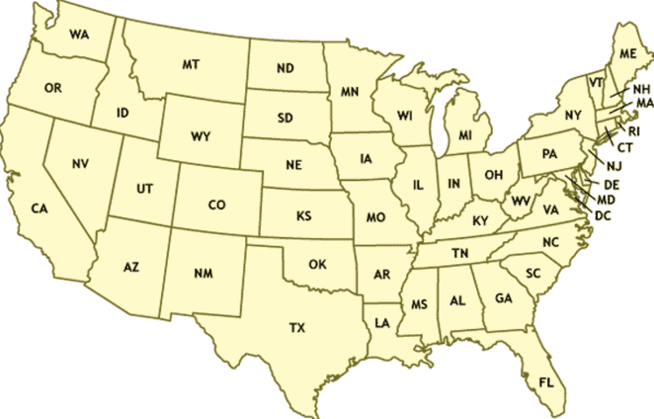

Slide 2
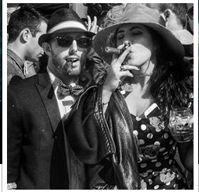

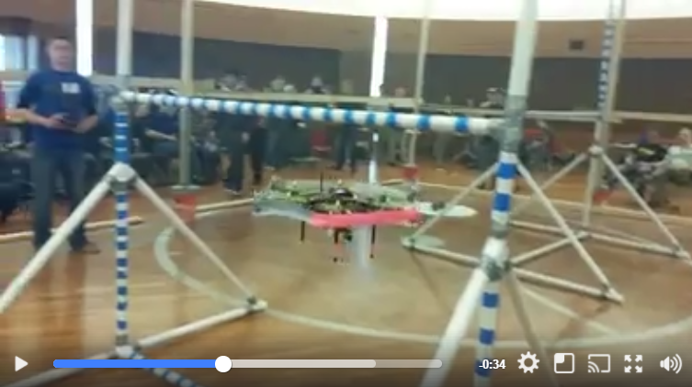
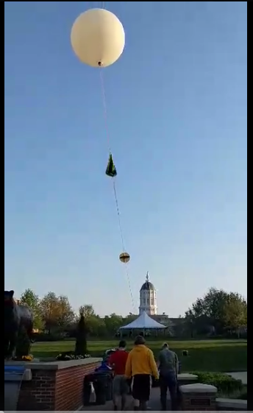
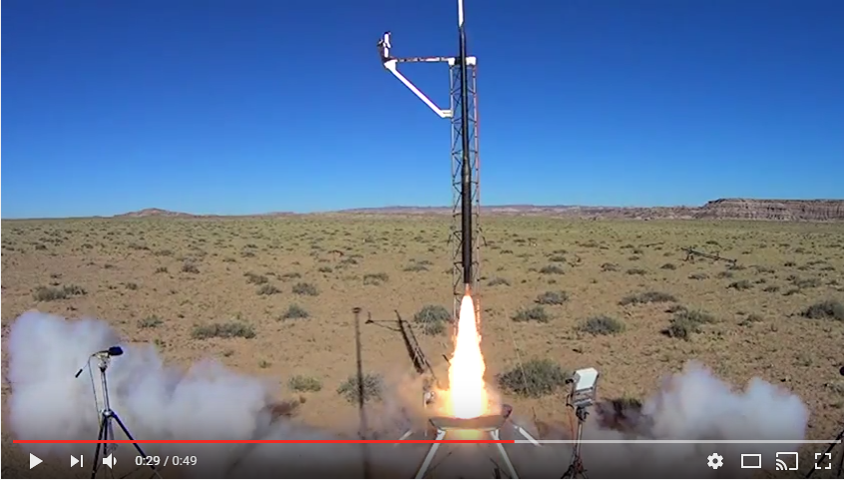
Expedited graduation date: BRANDON TORRES MECHANICAL ENGINEERING
Message
Email
Photos
Videos
Clubs: (CLICK FOR THE CLUB MIZZOU SITE)
American Society of Mechanical Engineers – Vice President
Students for the Exploration and Development of Space- Vice President
American Institute of Aeronautics and Astronautics-Treasurer
3D printing Club-Secretary
[ASME] American Society of Mechanical Engineers –
I held the position of team lead when we placed 2nd in the Lighter than Air ASME Robotics competition of 2014. Modeled and 3d printed the frame. Solely designed the landing structure. Soldered electronics and assisted in the coding of the software.
[5 sentence limit??]
See more
[SEDS]- Students for the Exploration and Development of Space-
Co-created Mizzou chapter of SEDS. Designed rocket to fly to the stratosphere and capture video footage of the curvature of the earth.
See more
[AIAA] American Institute of Aeronautics and Astronautics-
As treasure I managed all funding that came through AIAA. I was also the design leader of the Rocket Team. Designed recovery system of our rocket that went mach 1.4 and 9425ft in the air. Placed 4th in the ESRA Intercollegiate Rocket Engineering Competition.
See more
About me: (10 sentences)
Balsdjfalsdfafj
Asdjf;alsdjfasl;jdfa
Al;sdjfa;lsjdfal;jsdfa
A;lsjdf;lajsdfal;js
As;fjasl;jfal;jsd
Asldjfal;sjdfals;jfa
Al;jsdfa;ljsdfa;ljas
Df;a
[Click for Resume] – (Companies get full access. Students don’t. Students must ask permission with permission notification)

